Slide 1
Unit 3
Inheritance

Slide 2
Introduction
Java, Inheritance is an important pillar of OOP(Object-Oriented Programming). It is the mechanism in Java by which one class is allowed to inherit the features(fields and methods) of another class. In Java, Inheritance means creating new classes based on existing ones. A class that inherits from another class can reuse the methods and fields of that class.
Why Do We Need Java Inheritance?
Code Reusability: The code written in the Superclass is common to all subclasses. Child classes can directly use the parent class code.
Method Overriding: Method Overriding is achievable only through Inheritance. It is one of the ways by which Java achieves Run Time Polymorphism.
Abstraction: The concept of abstract where we do not have to provide all details, is achieved through inheritance. Abstraction only shows the functionality to the user.

Slide 3
Important Terminologies Used in Java Inheritance
Class: Class is a set of objects which shares common characteristics/ behavior and common properties/ attributes. Class is not a real-world entity. It is just a template or blueprint or prototype from which objects are created.
Super Class/Parent Class: The class whose features are inherited is known as a superclass(or a base class or a parent class).
Sub Class/Child Class: The class that inherits the other class is known as a subclass(or a derived class, extended class, or child class). The subclass can add its own fields and methods in addition to the superclass fields and methods.
Reusability: Inheritance supports the concept of “reusability”, i.e. when we want to create a new class and there is already a class that includes some of the code that we want, we can derive our new class from the existing class. By doing this, we are reusing the fields and methods of the existing class.

Slide 4
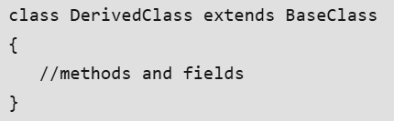
How to Use Inheritance in Java?
The extends keyword is used for inheritance in Java. Using the extends keyword indicates you are derived from an existing class. In other words, “extends” refers to increased functionality.
Example:
class Vehicle {
protected String brand = "Ford";
public void honk() {
System.out.println("Tuut, tuut!");
}
}
class Car extends Vehicle {
private String modelName = "Mustang";
public static void main(String[] args) {
Car myFastCar = new Car();
myFastCar.honk();
System.out.println(myFastCar.brand + " " + myFastCar.modelName);
}
}

Slide 5
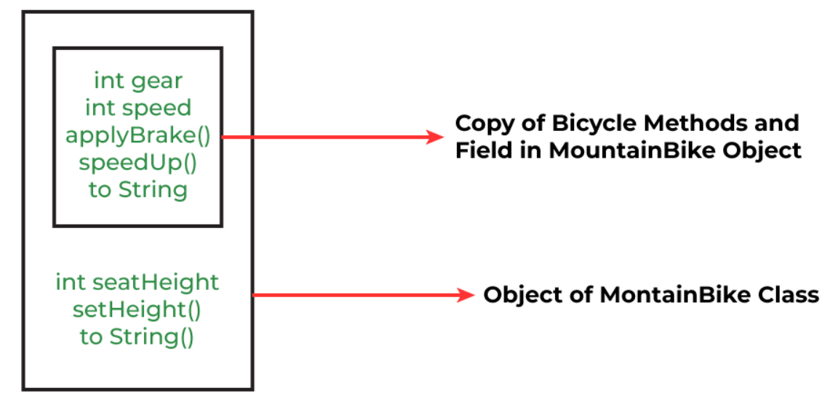
Illustrative image of the program:

Slide 6
Java Inheritance Types
Below are the different types of inheritance which are supported by Java.
Single Inheritance
Multilevel Inheritance
Hierarchical Inheritance
Multiple Inheritance
Hybrid Inheritance

Slide 7
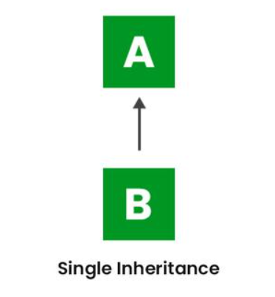
Single Inheritance
In single inheritance, a sub-class is derived from only one super class. It inherits the properties and behavior of a single-parent class. Sometimes, it is also known as simple inheritance. In the below figure, ‘A’ is a parent class and ‘B’ is a child class. The class ‘B’ inherits all the properties of the class ‘A’.

Slide 8
//Java Program to illustrate Single Inheritance
class Shape
{
public void display()
{
System.out.println("Inside display");
}
}
class Rectangle extends Shape
{
public void area()
{
System.out.println("Inside area");
}
}
public class Tester
{
public static void main(String[] arguments)
{ Rectangle rect = new Rectangle();
rect.display();
rect.area();
}
}

Slide 9
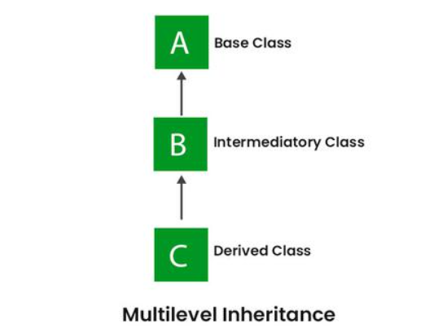
2. Multilevel Inheritance
In Multilevel Inheritance, a derived class will be inheriting a base class, and as well as the derived class also acts as the base class for other classes. In the below image, class A serves as a base class for the derived class B, which in turn serves as a base class for the derived class C. In Java, a class cannot directly access the grandparent’s members.

Slide 10
class Shape
{ public void display()
{ System.out.println("Inside display");
} }
class Rectangle extends Shape
{ public void area()
{ System.out.println("Inside area");
} }
class Cube extends Rectangle
{ public void volume()
{ System.out.println("Inside volume");
} }
public class Tester
{ public static void main(String[] arguments)
{ Cube cube = new Cube();
cube.display();
cube.area();
cube.volume();
} }

Slide 11
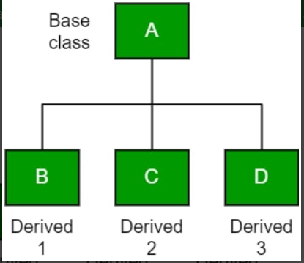
3. Hierarchical Inheritance
In Hierarchical Inheritance, one class serves as a superclass (base class) for more than one subclass. In the below image, class A serves as a base class for the derived classes B, C, and D.

Slide 12
// Java program to illustrate the concept of Hierarchical inheritance
class A { public void print_A() { System.out.println("Class A"); }
}
class B extends A { public void print_B() { System.out.println("Class B"); }
}
class C extends A { public void print_C() { System.out.println("Class C"); }
}
class D extends A { public void print_D() { System.out.println("Class D"); }
}
// Driver Class
public class Test {
public static void main(String[] args)
{
B obj_B = new B();
obj_B.print_A();
obj_B.print_B();
C obj_C = new C();
obj_C.print_A();
obj_C.print_C();
D obj_D = new D();
obj_D.print_A();
obj_D.print_D();
}
}

Slide 13
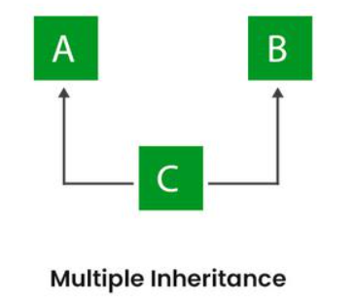
4. Multiple Inheritance (Through Interfaces)
In Multiple inheritances, one class can have more than one superclass and inherit features from all parent classes. Please note that Java does not support multiple inheritances with classes. In Java, we can achieve multiple inheritances only through Interfaces. In the image below, Class C is derived from interfaces A and B.

Slide 14
// Java program to illustrate the concept of Multiple inheritance
import java.io.*;
import java.lang.*;
import java.util.*;
interface One { public void print_A(); }
interface Two { public void print_B(); }
interface Three extends One, Two { public void print_A(); }
class Child implements Three { @Override public void print_A()
{ System.out.println(“A"); }
public void print_for() { System.out.println(“B"); } }
// Drived class
public class Main {
public static void main(String[] args)
{ Child c = new Child();
c.print_A();
c.print_B();
c.print_A();
}
}

Slide 15
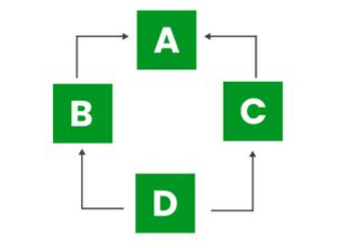
5. Hybrid Inheritance
It is a mix of two or more of the above types of inheritance. Since Java doesn’t support multiple inheritances with classes, hybrid inheritance involving multiple inheritance is also not possible with classes. In Java, we can achieve hybrid inheritance only through Interfaces if we want to involve multiple inheritance to implement Hybrid inheritance.
However, it is important to note that Hybrid inheritance does not necessarily require the use of Multiple Inheritance exclusively. It can be achieved through a combination of Multilevel Inheritance and Hierarchical Inheritance with classes, Hierarchical and Single Inheritance with classes. Therefore, it is indeed possible to implement Hybrid inheritance using classes alone, without relying on multiple inheritance type.

Slide 16
Interface
Another way to achieve abstraction in Java, is with interfaces.
An interface is a completely "abstract class" that is used to group related methods with empty bodies:
Example:
// interface interface Animal
{
public void animalSound(); // interface method (does not have a body)
public void run(); // interface method (does not have a body)
}
To access the interface methods, the interface must be "implemented" (kinda like inherited) by another class with the implements keyword (instead of extends). The body of the interface method is provided by the "implement" class:

Slide 17
interface Animal {
public void animalSound(); // interface method (does not have a body)
public void sleep(); // interface method (does not have a body)
}
class Pig implements Animal {
public void animalSound() {
System.out.println("The pig says: wee wee");
}
public void sleep() {
System.out.println("Zzz");
}
}
class Main {
public static void main(String[] args) {
Pig myPig = new Pig();
myPig.animalSound();
myPig.sleep();
}
}

